Slide 1
Chapter 24
Art in the Age of Romanticism, 1789–1848

Slide 2
Learning Objectives
Trace the impact of the French Revolution and Napoleonic Wars on art and architecture in the first half of the nineteenth century.
Discuss how the dramatic increase of nationalism was a function of Romantic fervor and the influence it had on art.
Discuss the new attitude toward nature that became dominant toward 1800 and the different ways that landscape was used in art to project Romantic emotion.
Explain why Romantic Art is not a style and instead is an attitude that can be expressed in different styles.
Describe the range of emotions and exotic themes that appealed to the Romantic imagination.

Slide 3
Spain and Spanish America
Spanish artists did not embrace Neoclassicism with as much enthusiasm as the Baroque style.
Court painter Francisco Goya shaped art at the end of the eighteenth century.
Colonial art and architecture intermingled Spanish Baroque with the traditions of native peoples.

Slide 4
Goya (1 of 3)
Francisco Goya (1746–1828) published a series of 80 etchings called Los Caprichos that included The Sleep of Reason Produces Monsters.
The images are an attack on contemporary Spanish morals.
Goya had to present the original metal plates to the king to insist that the images were not intentionally critical of the monarchy.

Slide 5
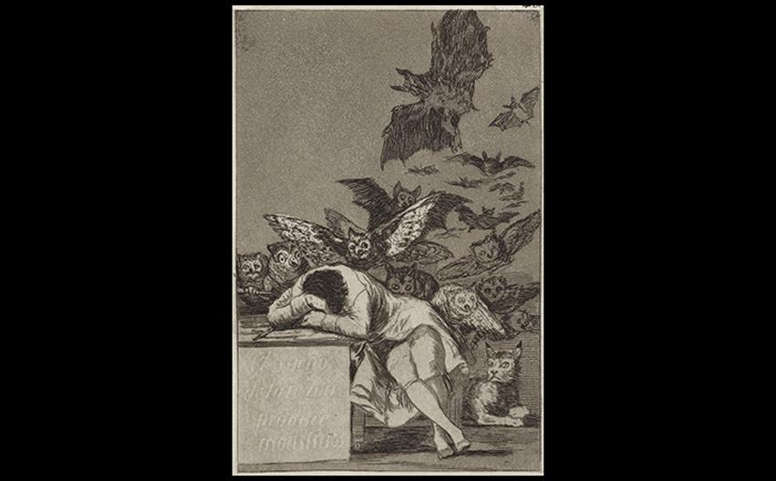
Francisco Goya THE SLEEP OF REASON PRODUCES MONSTERS No. 43 from Los Caprichos (The Caprices). 1796–1798; published 1799. Etching and aquatint, 8-1/2" × 6" (21.6 × 15.2 cm). Yale University Art Gallery. Bequest of Ralph Kirkpatrick, Hon. M.A. 1965 (1984.54.92.43). Image courtesy Yale University Art Gallery.
Notes:
Francisco Goya THE SLEEP OF REASON PRODUCES MONSTERS No. 43 from Los Caprichos (The Caprices). 1796–1798; published 1799. Etching and aquatint, 8-1/2" × 6" (21.6 × 15.2 cm). Yale University Art Gallery. Bequest of Ralph Kirkpatrick, Hon. M.A. 1965 (1984.54.92.43). Image courtesy Yale University Art Gallery.

Slide 6
Goya (2 of 3)
The portrait of the Family of Charles IV reveals Goya's desire for a more open Spain despite his allegiance to the king.
It was painted to resemble Velásquez's Las Meninas, but the figures seem bored and plain rather than regal.
Despite this, the royal family was satisfied with the depiction.

Slide 7
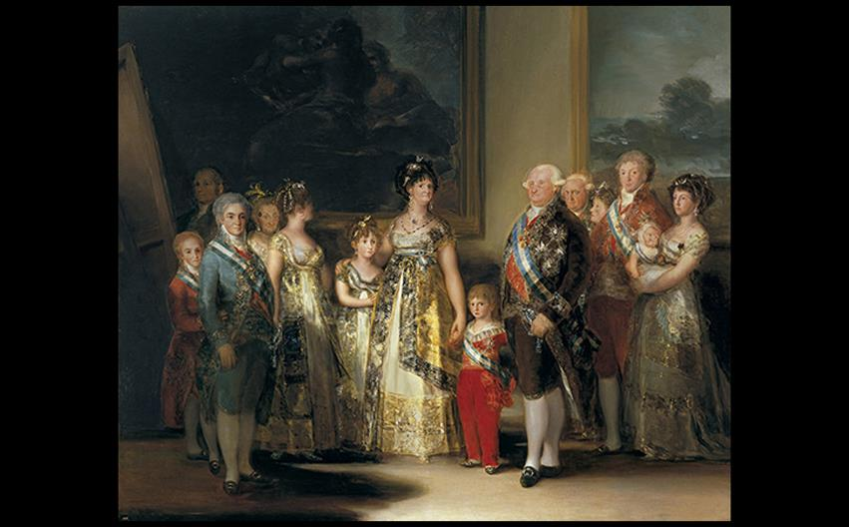
Francisco Goya FAMILY OF CHARLES IV 1800. Oil on canvas, 9'2" × 11' (2.79 × 3.36 m). Museo del Prado, Madrid. © 2016. Image copyright Museo Nacional del Prado. © Photo MNP/Photo Scala, Florence.
Notes:
Francisco Goya FAMILY OF CHARLES IV 1800. Oil on canvas, 9'2" × 11' (2.79 × 3.36 m). Museo del Prado, Madrid. © 2016. Image copyright Museo Nacional del Prado. © Photo MNP/Photo Scala, Florence.

Slide 8
Goya (3 of 3)
The Third of May, 1808 depicts the murder of hundreds of Spanish with its victims in blind terror.
The sensational event, loose brushwork, lifelike poses, unbalanced composition, and dramatic lighting reflect Romanticism.

Slide 9
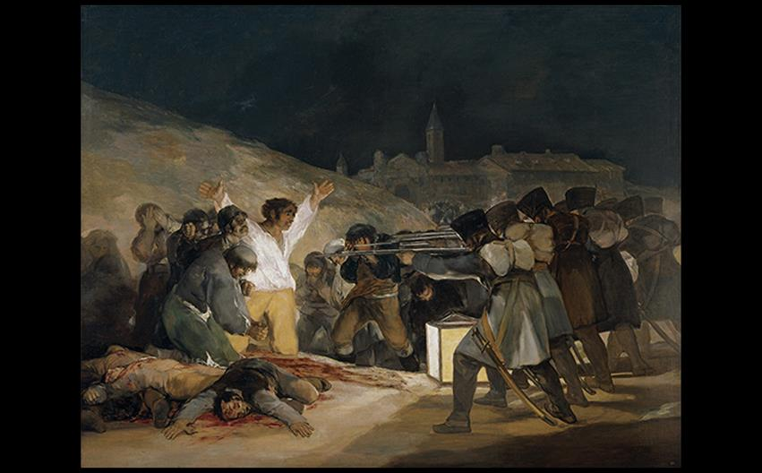
Francisco Goya THIRD OF MAY, 1808 1814–1815. Oil on canvas, 8'9" × 13'4" (2.67 × 4.06 m). Museo del Prado, Madrid. © 2016. Image copyright Museo Nacional del Prado. © Photo MNP/Scala, Florence.
Notes:
Francisco Goya THIRD OF MAY, 1808 1814–1815. Oil on canvas, 8'9" × 13'4" (2.67 × 4.06 m). Museo del Prado, Madrid. © 2016. Image copyright Museo Nacional del Prado. © Photo MNP/Scala, Florence.

Slide 10
The Art of the Americas Under Spain (1 of 3)
After the forced conversion of native peoples to Roman Catholicism, Christian iconography mixed with indigenous symbols.
Atrial crosses, such as the one in Mexico City, weaved the images from illustrated Bibles with representations of sacrificial blood and the tree of life, symbols common in indigenous art.

Slide 11
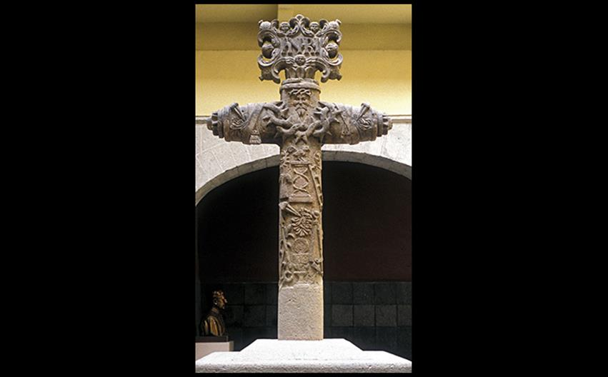
ATRIAL CROSS Before 1556. Stone, height 11'3" (3.45 m). Chapel of the Indians, Basilica of Guadalupe, Mexico City. © Jamie Lara
Notes:
ATRIAL CROSS Before 1556. Stone, height 11'3" (3.45 m). Chapel of the Indians, Basilica of Guadalupe, Mexico City. © Jamie Lara.

Slide 12
The Art of the Americas Under Spain (2 of 3)
In 1754, Pope Benedict XIV declared the Virgin of Guadalupe to be the patron saint of the Americas.
Guadalupe was the location where a Mexican peasant named Juan Diego claimed the Virgin Mary visited him to tell him to build a church on a particular hill.

Slide 13
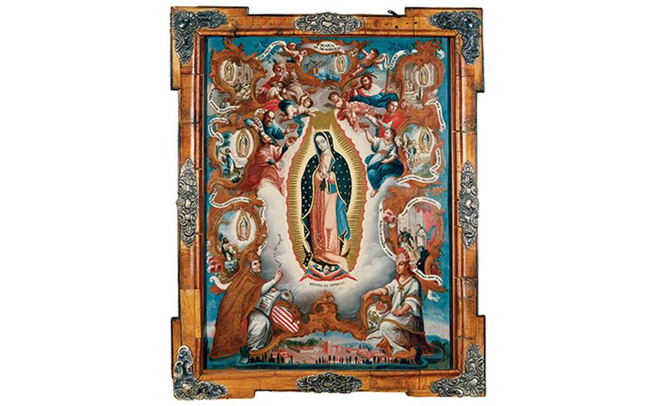
Sebastian Salcedo VIRGIN OF GUADALUPE 1779. Oil on panel and copper, 25" × 19" (63.5 × 48.3 cm). Denver Art Museum. Funds contributed by Mr. and Mrs. George G. Anderman and an anonymous donor (1976.56).
Notes:
Sebastian Salcedo VIRGIN OF GUADALUPE 1779. Oil on panel and copper, 25" × 19" (63.5 × 48.3 cm). Denver Art Museum. Funds contributed by Mr. and Mrs. George G. Anderman and an anonymous donor (1976.56).

Slide 14
The Art of the Americas Under Spain (3 of 3)
Spanish architecture found its way to missionaries such as the Mission San Xavier del Bac near Tuscon, Arizona.
The people of the Pima nation prepared the site, which was built upon by Velderrain in 1776.

Slide 15
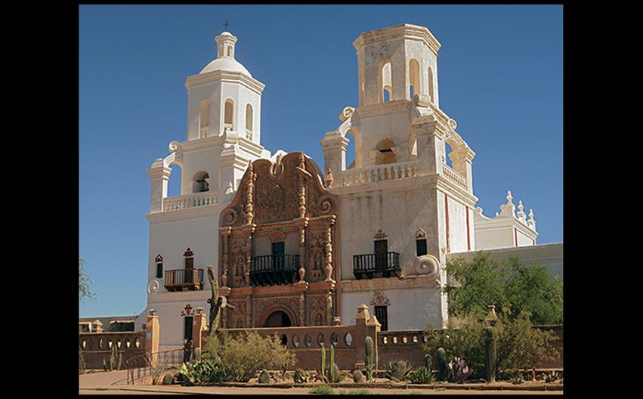
MISSION SAN XAVIER DEL BAC Near Tucson, Arizona. 1784–1797. Paul Moore/Fotolia.
Notes:
MISSION SAN XAVIER DEL BAC Near Tucson, Arizona. 1784–1797. Paul Moore/Fotolia.

Slide 16
The Development of Neoclassicism and Romanticism into the Nineteenth Century
Neoclassicism and Romanticism existed side by side in European and American art.
Romanticism took a variety of forms with the common thread of emotional expressiveness.
Subject matter was dramatic and took cues from literature, current events, nature, or the artist's imagination.

Slide 17
Developments in France (1 of 10)
Paris attracted students due to the École des Beaux-Arts as well as private instruction from ateliers.
There was a divide between poussinistes and rubénistes as to whether line or color was more important in art.
The value of the preliminary sketch, esquisse, was hotly debated.

Slide 18
Developments in France (2 of 10)
The Grand Manner Paintings of David and Gros
Four years before Napoleon became emperor, David painted Napoleon Crossing the Saint-Bernard, an idealized vision of the emperor leading his troops across the Alps.
Neoclassical delineation of forms meets the diagonals and flowing draperies of the Baroque Grand Manner.

Slide 19
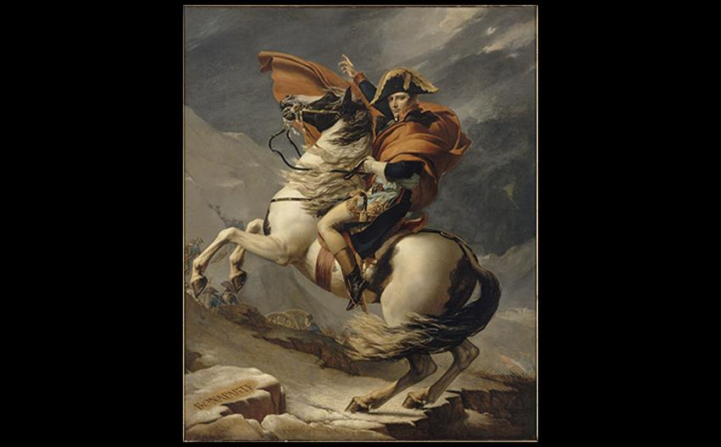
Jacques-Louis David NAPOLEON CROSSING THE SAINT-BERNARD 1800–1801. Oil on canvas, 8'11" × 7'7" (2.7 × 2.3 m). Versailles, Châteaux de Versailles et de Trianon. Photo © RMN-Grand Palais (Château de Versailles)/Franck Raux.
Notes:
Jacques-Louis David NAPOLEON CROSSING THE SAINT-BERNARD 1800–1801. Oil on canvas, 8'11" × 7'7" (2.7 × 2.3 m). Versailles, Châteaux de Versailles et de Trianon. Photo © RMN-Grand Palais (Château de Versailles)/Franck Raux.

Slide 20
Developments in France (3 of 10)
The Grand Manner Paintings of David and Gros
Antoine-Jean Gros worked in David's studio and eventually gained commissions from Napoleon as well.
Napoleon in the Plague House at Jaffa represents an actual event in the Grand Manner.
The scene is meant to incite veneration of Napoleon specifically.

Slide 21
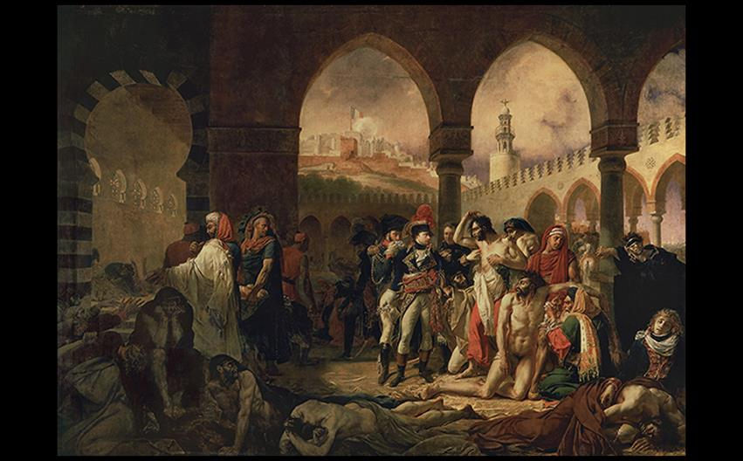
Antoine-Jean Gros NAPOLEON IN THE PLAGUE HOUSE AT JAFFA 1804. Oil on canvas, 17'5" × 23'7" (5.32 × 7.2 m). Musée du Louvre, Paris. Photo © RMN-Grand Palais (musée du Louvre)/Thierry Le Mage.
Notes:
Antoine-Jean Gros NAPOLEON IN THE PLAGUE HOUSE AT JAFFA 1804. Oil on canvas, 17'5" × 23'7" (5.32 × 7.2 m). Musée du Louvre, Paris. Photo © RMN-Grand Palais (musée du Louvre)/Thierry Le Mage.

Slide 22
Developments in France (4 of 10)
Géricault
Théodore Géricault's brief career was launched by the scandalous painting of the "Medusa" shipwreck.
Critics and royalists interpreted the painting as a political jibe at the king.
A debate was sparked about the point at which a work crosses the line between art and political advocacy.

Slide 23
Developments in France (5 of 10)
Géricault
Géricault painted a dramatic representation of the shipwreck of the Medusa.
In reality, 15 passengers survived by eating human flesh; Géricault paints the moment when their rescue ship is spotted.
Struggle of humanity against the elements is a greater theme of the work.

Slide 24
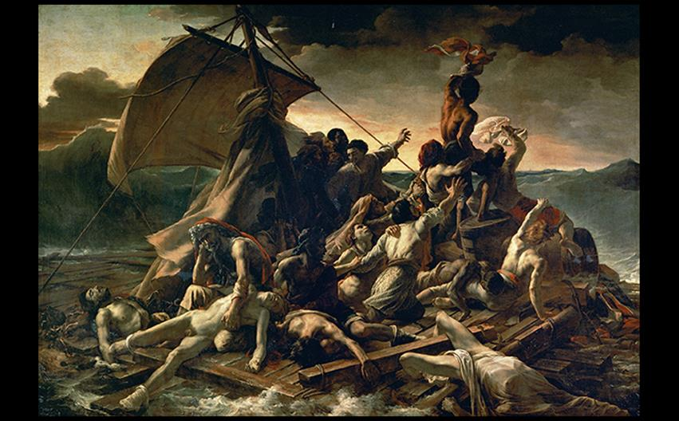
Théodore Géricault THE RAFT OF THE MEDUSA 1818–1819. Oil on canvas, 16'1" × 23'6" (4.9 × 7.16 m). Musée du Louvre, Paris. © akg-images/Erich Lessing.
Notes:
Théodore Géricault THE RAFT OF THE MEDUSA 1818–1819. Oil on canvas, 16'1" × 23'6" (4.9 × 7.16 m). Musée du Louvre, Paris. © akg-images/Erich Lessing.

Slide 25
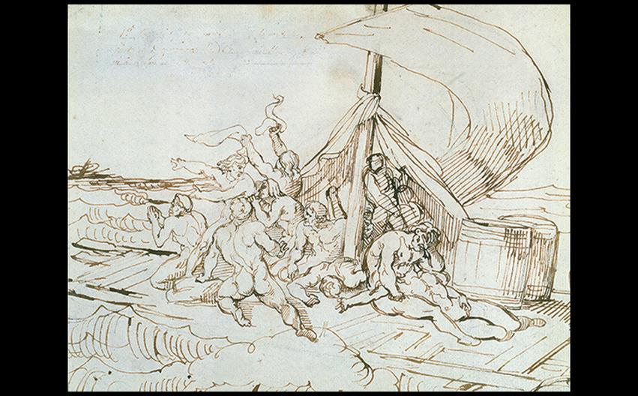
Théodore Géricault THE SIGHTING OF THE ARGUS 1818. Pen and ink on paper, 13-3/4" × 16-1/8" (34.9 × 41 cm). Musée des Beaux-Arts, Lille. Photo © RMN-Grand Palais/Philipp Bernard.
Notes:
Théodore Géricault THE SIGHTING OF THE ARGUS 1818. Pen and ink on paper, 13-3/4" × 16-1/8" (34.9 × 41 cm). Musée des Beaux-Arts, Lille. Photo © RMN-Grand Palais/Philipp Bernard.

Slide 26
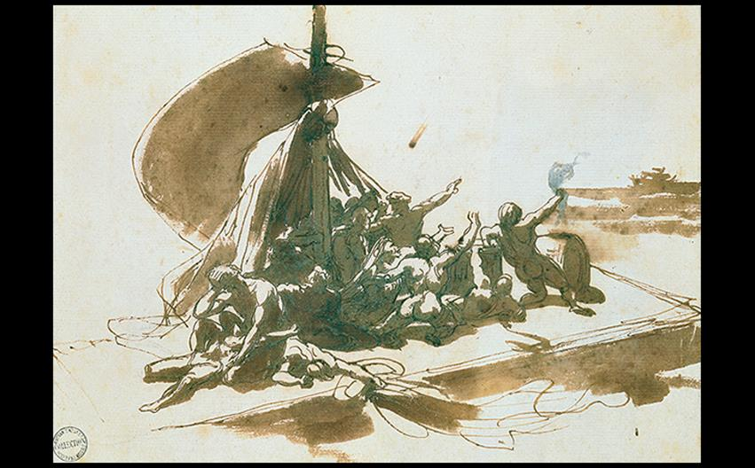
Théodore Géricault THE SIGHTING OF THE "ARGUS" 1818. Pen and ink, sepia wash on paper, 8-1/8" × 11-1/4" (20.6 × 28.6 cm). Musée des Beaux-Arts, Rouen. Photo © RMN-Grand Palais/Philipp Bernard.
Notes:
Théodore Géricault THE SIGHTING OF THE "ARGUS" 1818. Pen and ink, sepia wash on paper, 8-1/8" × 11-1/4" (20.6 × 28.6 cm). Musée des Beaux-Arts, Rouen. Photo © RMN-Grand Palais/Philipp Bernard.

Slide 27
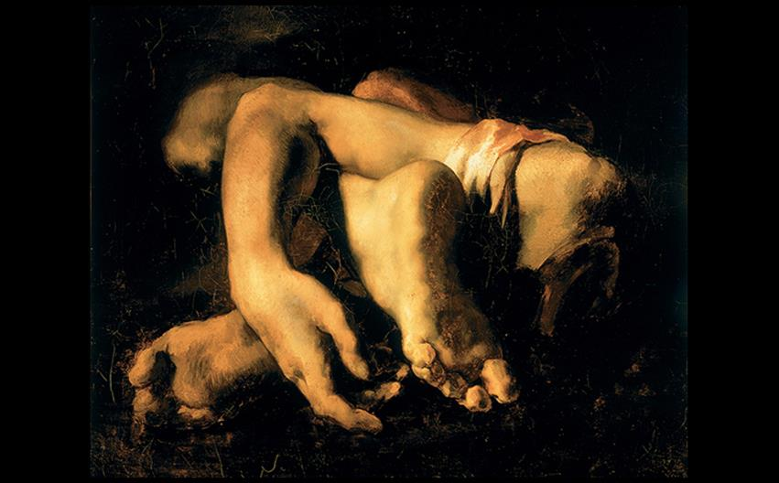
Théodore Géricault STUDY OF HANDS AND FEET 1818–1819. Oil on canvas, 20-1/2" × 25-3/18" (52 × 64 cm). Musée Fabre de Montpellier. Musée Fabre de Montpellier Agglomération. Photo: Frédéric Jaulmes.
Notes:
Théodore Géricault STUDY OF HANDS AND FEET 1818–1819. Oil on canvas, 20-1/2" × 25-3/18" (52 × 64 cm). Musée Fabre de Montpellier. Musée Fabre de Montpellier Agglomération. Photo: Frédéric Jaulmes

Slide 28
Developments in France (6 of 10)
Delacroix and Rude
Eugène Delacroix became the leader of the Romantic movement.
Liberty Leading the People is his most famous work, summarizing the destiny of France after the fall of Napoleon.
This is not the record of the massive July 1830 uprising, but an imaginative re-creation taking the emotional climate into account.

Slide 29
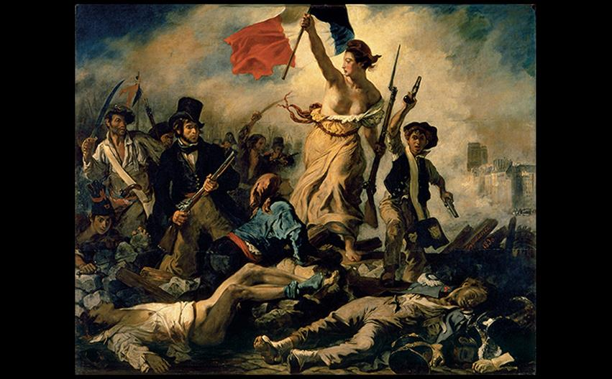
Eugène Delacroix LIBERTY LEADING THE PEOPLE: JULY 28, 1830 1830. Oil on canvas, 8'6-1/2" × 10'8" (2.6 × 3.25 m). Musée du Louvre, Paris. Photo © Musée du Louvre, Dist. RMN-Grand Palais/Philippe Fuzeau.
Notes:
Eugène Delacroix LIBERTY LEADING THE PEOPLE: JULY 28, 1830 1830. Oil on canvas, 8'6-1/2" × 10'8" (2.6 × 3.25 m). Musée du Louvre, Paris. Photo © Musée du Louvre, Dist. RMN-Grand Palais/Philippe Fuzeau.

Slide 30
Developments in France (7 of 10)
Delacroix and Rude
François Rude was commissioned for a sculpture to decorate the main arcade on the triumphal arch on the Champs-Élysées.
The sculpture, known as the Marsellaise, portrays Classical details but an overall Romantic impact with a crowded, excited group of figures.

Slide 31
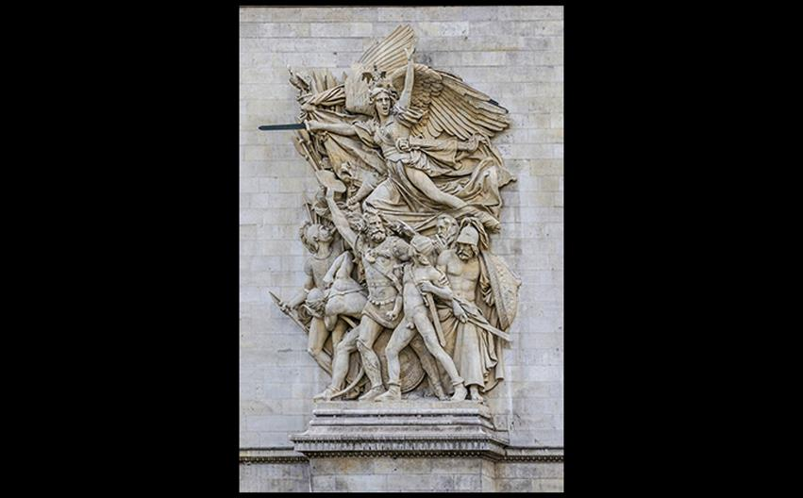
François Rude DEPARTURE OF THE VOLUNTEERS OF 1792 (THE MARSEILLAISE) Arc de Triomphe, Place de l'Étoile, Paris. 1833–1836. Limestone, height approx. 42' (12.8 m). © Kiev.Victor/Shutterstock.
Notes:
François Rude DEPARTURE OF THE VOLUNTEERS OF 1792 (THE MARSEILLAISE) Arc de Triomphe, Place de l'Étoile, Paris. 1833–1836. Limestone, height approx. 42' (12.8 m). © Kiev.Victor/Shutterstock.

Slide 32
Developments in France (8 of 10)
Ingres
Jean-Auguste-Dominique Ingres, trained by David, won the Prix de Rome and eventually served as director of the French Academy in Rome until 1841.
His Large Odalisque shows a woman turning her naked body away from her (assumed) master's gaze.
Although the posture is Neoclassical, elongated, anatomically incorrect lines of her back and hip reflect Romanticism.

Slide 33
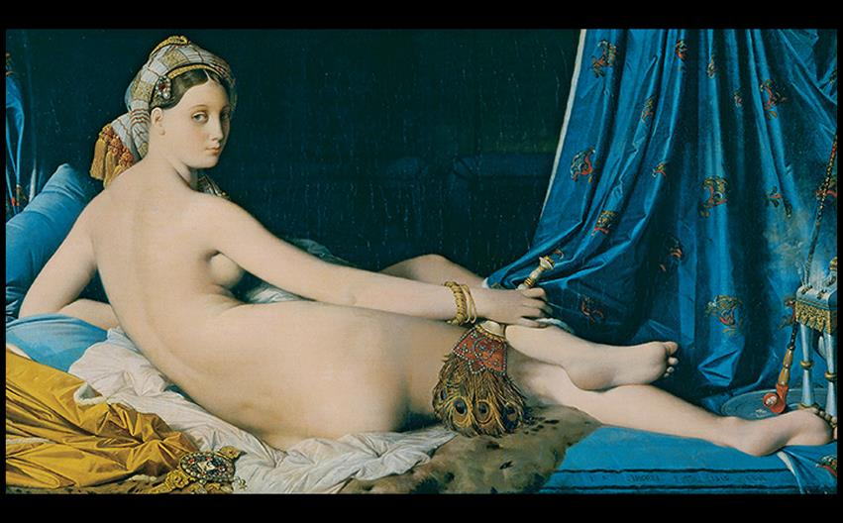
Jean-Auguste-Dominique Ingres LARGE ODALISQUE 1814. Oil on canvas, approx. 35" × 64" (88.9 × 162.5 cm). Musée du Louvre, Paris. Photo © RMN-Grand Palais (musée du Louvre)/Thierry Le Mage.
Notes:
Jean-Auguste-Dominique Ingres LARGE ODALISQUE 1814. Oil on canvas, approx. 35" × 64" (88.9 × 162.5 cm). Musée du Louvre, Paris. Photo © RMN-Grand Palais (musée du Louvre)/Thierry Le Mage.

Slide 34
Developments in France (9 of 10)
Ingres
Despite his distaste for portraiture, Ingres created a flattering and credible representation of his subject in Portrait of Madame Désiré Raoul-Rochette.
The sitter's face is emphasized with careful shading; the details in her clothing are subdued.

Slide 35
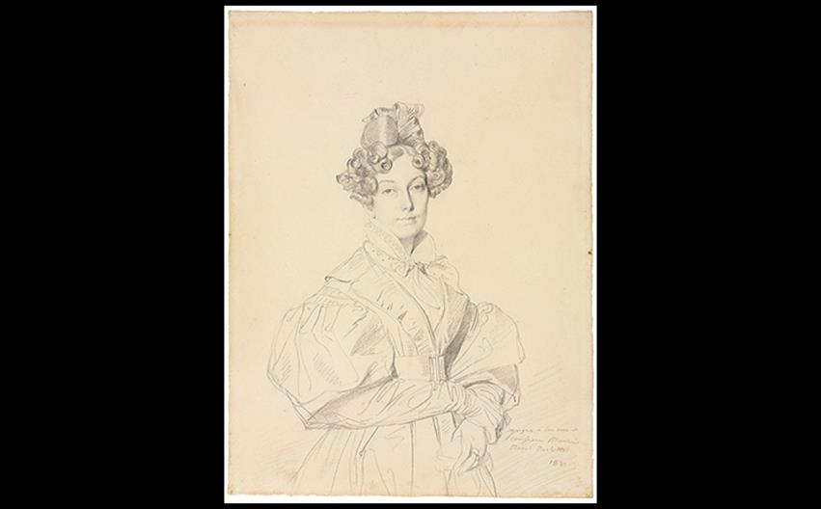
Jean-Auguste-Dominique Ingres PORTRAIT OF MADAME DÉSIRÉ RAOUL-ROCHETTE 1830. Graphite on paper, 12-5/8" × 9-1/2" (32.2 × 24.1 cm). Cleveland Museum of Art. Purchase from the J. H. Wade Fund (1927.437). Bridgeman Images.
Notes:
Jean-Auguste-Dominique Ingres PORTRAIT OF MADAME DÉSIRÉ RAOUL-ROCHETTE 1830. Graphite on paper, 12-5/8" × 9-1/2" (32.2 × 24.1 cm). Cleveland Museum of Art. Purchase from the J. H. Wade Fund (1927.437). Bridgeman Images.

Slide 36
Technique: Lithography
In this technique, the artists draws on a flat surface with a crayonlike instrument, then wipes the surface with water and an oil-based ink.
Paper is pressed to the stone with a scraper and rolled through a flatbed press.
Daumier's The Print Lovers shows the trend growing among artists.

Slide 37
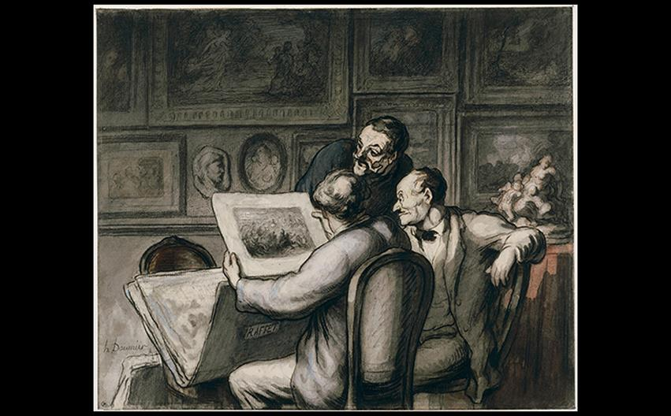
Honoré Daumier THE PRINT LOVERS c. 1863–1865. Watercolor, black pencil, black ink, gray wash, 10-1/8" × 12-1/8" (25.8 × 30.7 cm). Musée du Louvre, Paris. Photo © RMN-Grand Palais (musée du Louvre).
Notes:
Honoré Daumier THE PRINT LOVERS c. 1863–1865. Watercolor, black pencil, black ink, gray wash, 10-1/8" × 12-1/8" (25.8 × 30.7 cm). Musée du Louvre, Paris. Photo © RMN-Grand Palais (musée du Louvre).

Slide 38
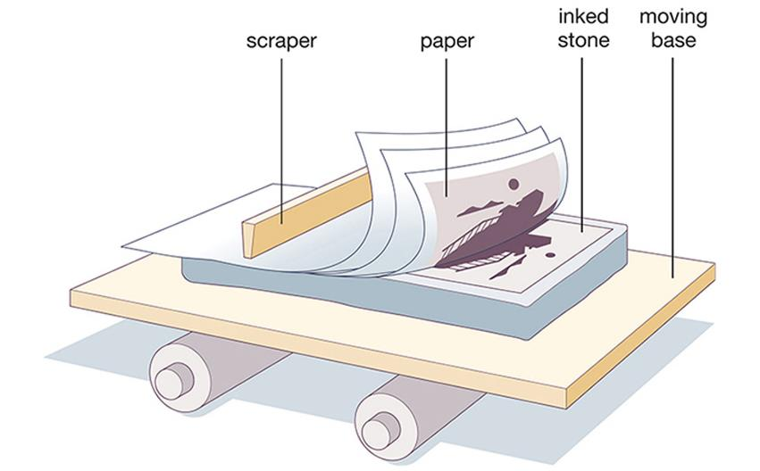
TECHNIQUE: Lithography Diagram of the lithographic process.
Notes:
TECHNIQUE: Lithography Diagram of the lithographic process.

Slide 39
Developments in France (10 of 10)
Daumier
Honoré Daumier was a skillful lithographer, portraying the atrocities on Rue Transnonain wherein a riot squad killed everyone in the building in which they believe a marksman was hiding.

Slide 40
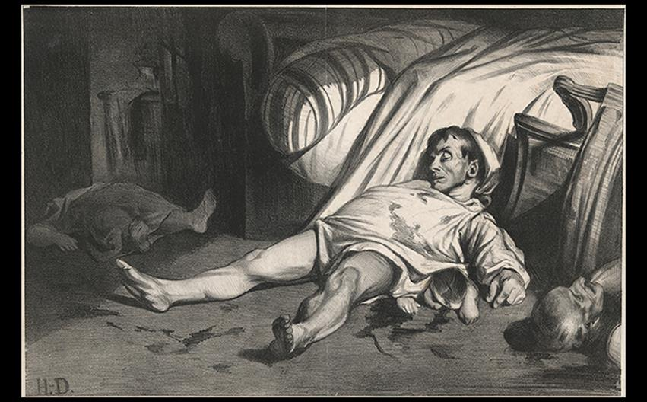
Honoré Daumier RUE TRANSNONAIN, LE 15 AVRIL 1834 1834. Lithograph, 11" × 17-3/8" (28 × 44 cm). Yale University Art Gallery, Everett V. Meeks, B.A. 1901, Fund (1982.120.4). Image courtesy Yale University Art Gallery.
Notes:
Honoré Daumier RUE TRANSNONAIN, LE 15 AVRIL 1834 1834. Lithograph, 11" × 17-3/8" (28 × 44 cm). Yale University Art Gallery, Everett V. Meeks, B.A. 1901, Fund (1982.120.4). Image courtesy Yale University Art Gallery.

Slide 41
Romantic Landscape Painting (1 of 7)
Landscape painting was either tranquil or dramatic based on subject matter.
Romantic artists found the unpredictable, uncontrollable force of nature as an analogy to human moods and emotions.

Slide 42
Romantic Landscape Painting (2 of 7)
Constable
John Constable (1776–1837) specialized in scenes of rural tranquility.
The Hay Wain shows a slow-moving, carefully constructed scene of England.
The nostalgic landscape is comfortable, rural, and idyllic, in contrast to the industrializing world around it.

Slide 43
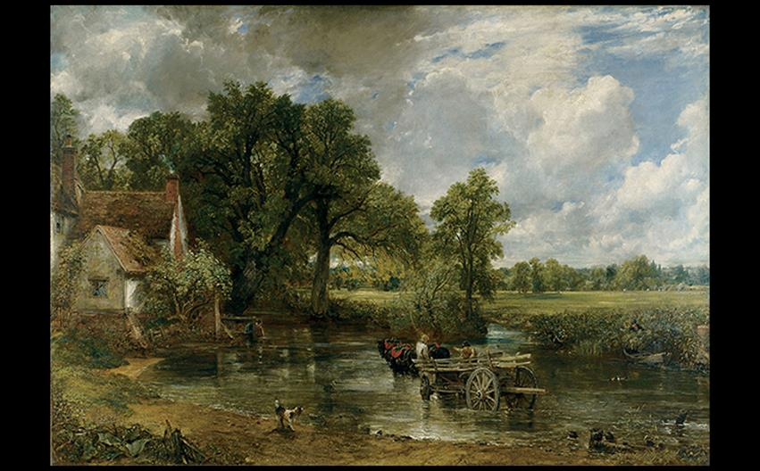
John Constable THE HAY WAIN 1821. Oil on canvas, 51-1/4" × 73" (130.2 × 185.4 cm). National Gallery, London. Gift of Henry Vaughan, 1886. © 2016. Copyright The National Gallery, London/Scala, Florence.
Notes:
John Constable THE HAY WAIN 1821. Oil on canvas, 51-1/4" × 73" (130.2 × 185.4 cm). National Gallery, London. Gift of Henry Vaughan, 1886. © 2016. Copyright The National Gallery, London/Scala, Florence.

Slide 44
Romantic Landscape Painting (3 of 7)
Turner
The notion of the sublime according to Edmund Burke involves feelings that transcend everyday feelings when one views something that instills fascination mixed with fear.

Slide 45
Romantic Landscape Painting (4 of 7)
Turner
Joseph Mallord William Turner (1775–1851) manipulated colored light and atmosphere in dramatic, moody storm settings.
Snowstorm: Hannibal and His Army Crossing the Alps shows figures reduced to specks as a vortex of wind, mist, and snow become the subject.

Slide 46
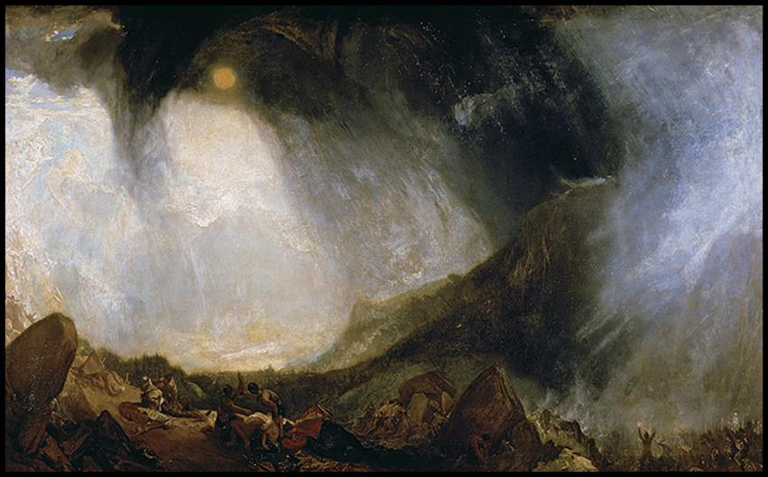
Joseph Mallord William Turner SNOWSTORM: HANNIBAL AND HIS ARMY CROSSING THE ALPS 1812. Oil on canvas, 4'9" × 7'9" (1.46 × 2.39 m). Tate, London. © akg-images/De Agostini Picture Library.
Notes:
Joseph Mallord William Turner SNOWSTORM: HANNIBAL AND HIS ARMY CROSSING THE ALPS 1812. Oil on canvas, 4'9" × 7'9" (1.46 × 2.39 m). Tate, London. © akg-images/De Agostini Picture Library.

Slide 47
Romantic Landscape Painting (5 of 7)
Turner
The artist brought the sublime to a contemporary event in The Burning of the Houses of Lords and Commons, 16th October 1834.
Turner witnessed the event himself and made watercolor sketches on the site from which to create the large-scale painting.

Slide 48
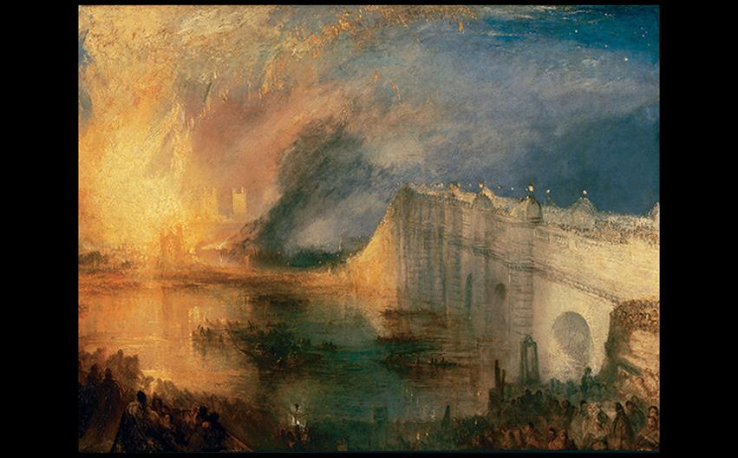
Joseph Mallord William Turner THE BURNING OF THE HOUSES OF LORDS AND COMMONS, 16TH OCTOBER 1834 Oil on canvas, 36-1/4" × 48-1/2" (92.1 × 123.2 cm). Philadelphia Museum of Art. The John Howard McFadden Collection, 1928. © 2016. Photo The Philadelphia Museum of Art/Art Resource/Scala, Florence.
Notes:
Joseph Mallord William Turner THE BURNING OF THE HOUSES OF LORDS AND COMMONS, 16TH OCTOBER 1834 Oil on canvas, 36-1/4" × 48-1/2" (92.1 × 123.2 cm). Philadelphia Museum of Art. The John Howard McFadden Collection, 1928. © 2016. Photo The Philadelphia Museum of Art/Art Resource/Scala, Florence.

Slide 49
Romantic Landscape Painting (6 of 7)
Cole and Friedrich
Thomas Cole's The Oxbow was a dramatic, monumentally-scaled painting of a view from Mount Holyoke, MA.
The artist frequently worked from observation and this painting represents a specific place and time.
He contrasts two sides of the American landscape: the dense, stormy wilderness and the congenial, pastoral valleys.

Slide 50
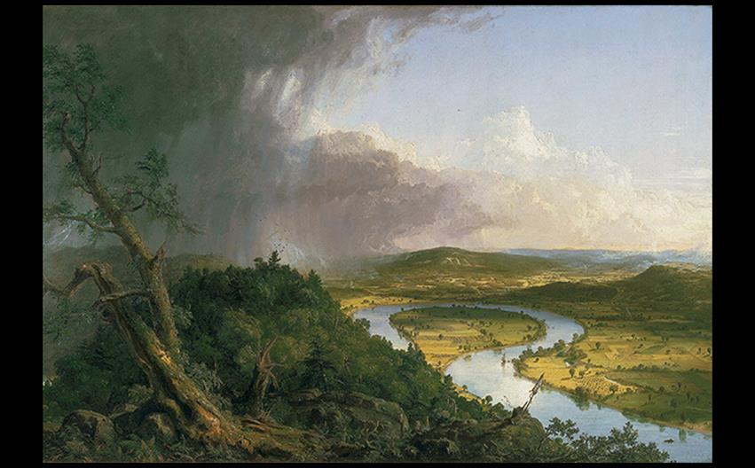
Thomas Cole THE OXBOW 1836. Oil on canvas, 51-1/2" × 76" (1.31 × 1.94 m). Metropolitan Museum of Art, New York. Gift of Mrs. Russell Sage, 1908 (08.228). © 2016. Image copyright The Metropolitan Museum of Art/Art Resource/Scala, Florence.
Notes:
Thomas Cole THE OXBOW 1836. Oil on canvas, 51-1/2" × 76" (1.31 × 1.94 m). Metropolitan Museum of Art, New York. Gift of Mrs. Russell Sage, 1908 (08.228). © 2016. Image copyright The Metropolitan Museum of Art/Art Resource/Scala, Florence.

Slide 51
Romantic Landscape Painting (7 of 7)
Cole and Friedrich
In Germany, Caspar David Friedrich (1774–1840) used landscape toward spiritual revelation.
He was inspired by Kosegarten's writings and teachings, believing landscape to be God's "Book of Nature."
Abbey in an Oak Forest shows a funeral procession in the fog with silhouetted tree branches a Gothic wall in ruins.

Slide 52
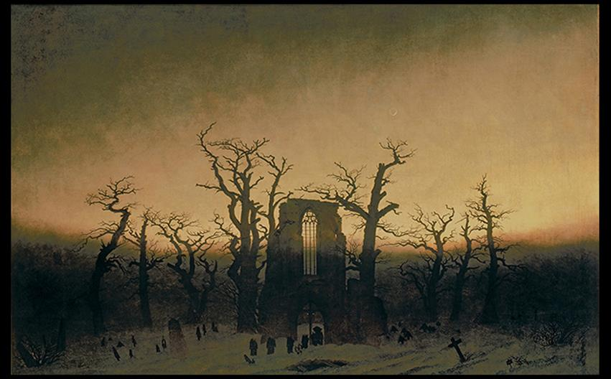
Caspar David Friedrich ABBEY IN AN OAK FOREST 1809–1810. Oil on canvas, 44" × 68-1/2" (111.8 × 174 cm). Nationalgalerie, Berlin. © Photo Scala, Florence/bpk, Bildagentur für Kunst, Kultur und Geschichte, Berlin. Photo: Joerg P. Anders.
Notes:
Caspar David Friedrich ABBEY IN AN OAK FOREST 1809–1810. Oil on canvas, 44" × 68-1/2" (111.8 × 174 cm). Nationalgalerie, Berlin. © Photo Scala, Florence/bpk, Bildagentur für Kunst, Kultur und Geschichte, Berlin. Photo: Joerg P. Anders.

Slide 53
British and American Architecture (1 of 6)
Neoclassicism was often applied to secular public buildings for a sense of grandeur and timelessness.
Romanticism in architecture evoked the Gothic with its associations of spirituality and community.

Slide 54
British and American Architecture (2 of 6)
Gothic Architecture
The Houses of Parliament were erected in the Gothic Revival style.
Barry and Pugin devised a Classical plan with balanced symmetry.
For Pugin, Gothic was more of a principle than a style.
It embodied two "great rules" of architecture regarding convenience and ornamentation.

Slide 55
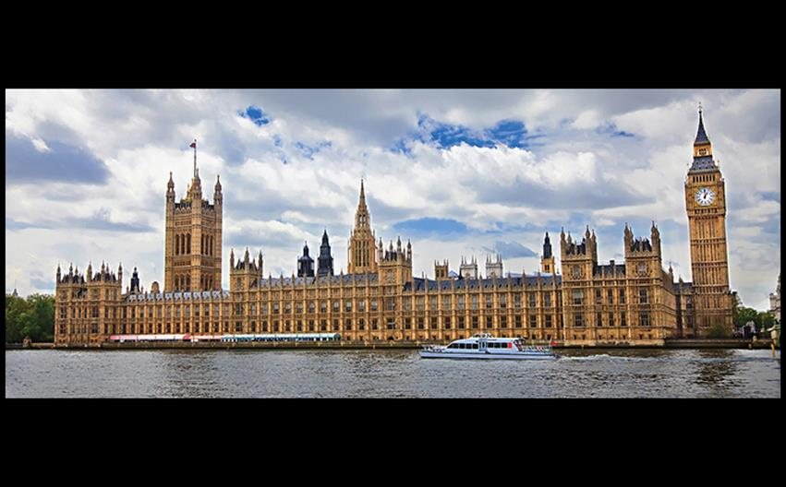
Charles Barry and Augustus Welby Northmore Pugin HOUSES OF PARLIAMENT, LONDON 1836–1860. Royal Commission on the Historical Monuments of England, London. © S.Borisov/Shutterstock.
Notes:
Charles Barry and Augustus Welby Northmore Pugin HOUSES OF PARLIAMENT, LONDON 1836–1860. Royal Commission on the Historical Monuments of England, London. © S.Borisov/Shutterstock.

Slide 56
British and American Architecture (3 of 6)
Gothic Architecture
Most early Gothic Revival buildings were Roman Catholic or Anglican/Episcopalian churches.
The Trinity Church in New York is an example.
Details are rendered with historical accuracy, aside from the vaults being plaster and not masonry.

Slide 57
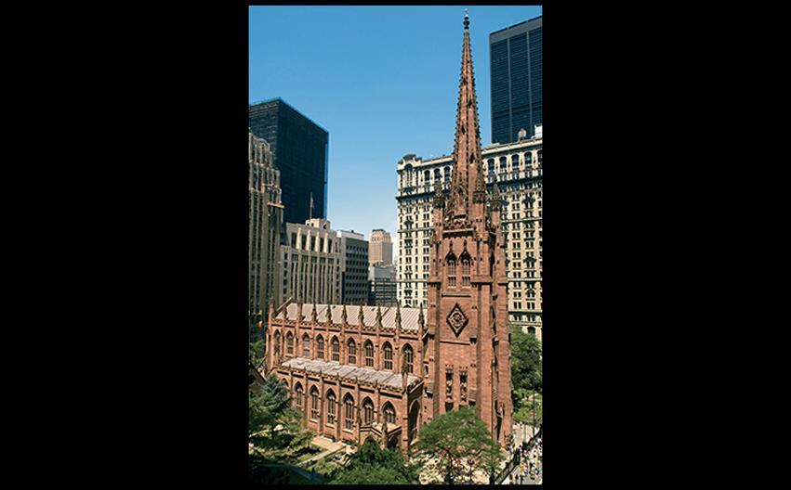
Richard Upjohn TRINITY CHURCH, NEW YORK CITY 1839–1846. Leo Sorel Photography.
Notes:
Richard Upjohn TRINITY CHURCH, NEW YORK CITY 1839–1846. Leo Sorel Photography.

Slide 58
British and American Architecture (4 of 6)
Neoclassical Architecture
Neoclassical designs of national museums in European capitals evoked them as temples of culture and expressions of nationalism.
The Altes Museum in Berlin features a façade comprised of 18 Ionic columns raised on a platform.
Karl Friedrich Schinkel was commissioned to build it for the royal art collection.

Slide 59
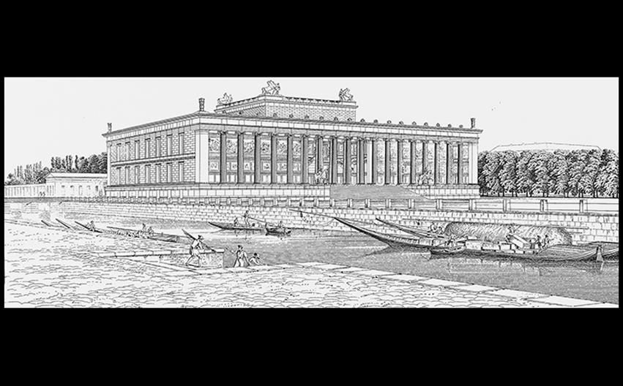
Karl Friedrich Schinkel ALTES MUSEUM, BERLIN 1822–1830. © 2016. Photo Scala, Florence/bpk, Bildagentur für Kunst, Kultur und Geschichte, Berlin. Photo: Volker-H Schneider.
Notes:
Karl Friedrich Schinkel ALTES MUSEUM, BERLIN 1822–1830. © 2016. Photo Scala, Florence/bpk, Bildagentur für Kunst, Kultur und Geschichte, Berlin. Photo: Volker-H Schneider

Slide 60
British and American Architecture (5 of 6)
Neoclassical Architecture
Neoclassical style was utilized for the building of the U.S. Capitol in Washington, D.C.
Benjamin Henry Latrobe was hired to expand upon the symbolism introduced by amateur architect, William Thornton.

Slide 61
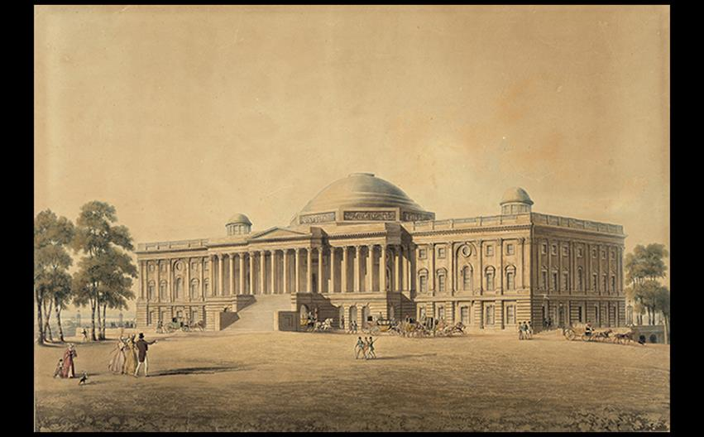
Benjamin Henry Latrobe U.S. CAPITOL, WASHINGTON, DC c. 1808. Engraving by T. Sutherland, 1825. Library of Congress, Prints and Photographs Division,Washington D.C. Courtesy the Library of Congress.
Notes:
Benjamin Henry Latrobe U.S. CAPITOL, WASHINGTON, DC c. 1808. Engraving by T. Sutherland, 1825. Library of Congress, Prints and Photographs Division,Washington D.C. Courtesy the Library of Congress.

Slide 62
British and American Architecture (6 of 6)
Neoclassical Architecture
Thomas Jefferson designed his Virginia residence, Monticello, in the 1770s as influenced by Roman architecture and British Palladian villas.

Slide 63
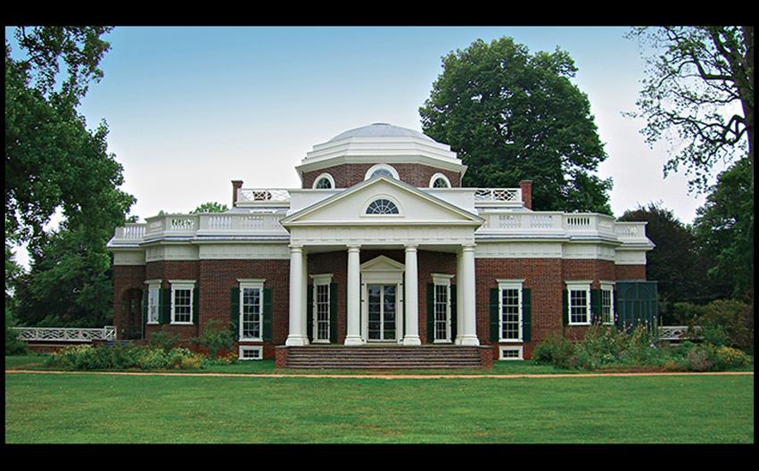
Thomas Jefferson MONTICELLO Charlottesville, Virginia. 1769–1782, 1796–1809. © Ffooter/Shutterstock.
Notes:
Thomas Jefferson MONTICELLO Charlottesville, Virginia. 1769–1782, 1796–1809. © Ffooter/Shutterstock.

